Slide 1







Slide 2
Invest Alberta – BRAED
Investor Attraction Pilot Project
Challenge
How to move beyond
opportunity assessment studies
and use the tools we have

Slide 3
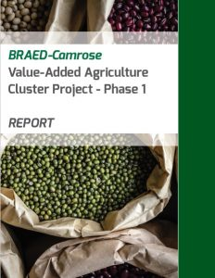
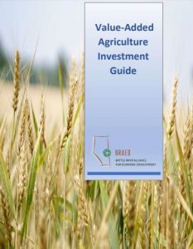


Slide 4
Invest Alberta – BRAED
Investor Attraction Pilot Project
Challenge
How to help BRAED’s diverse membership benefit equally from investment attraction work

Slide 5
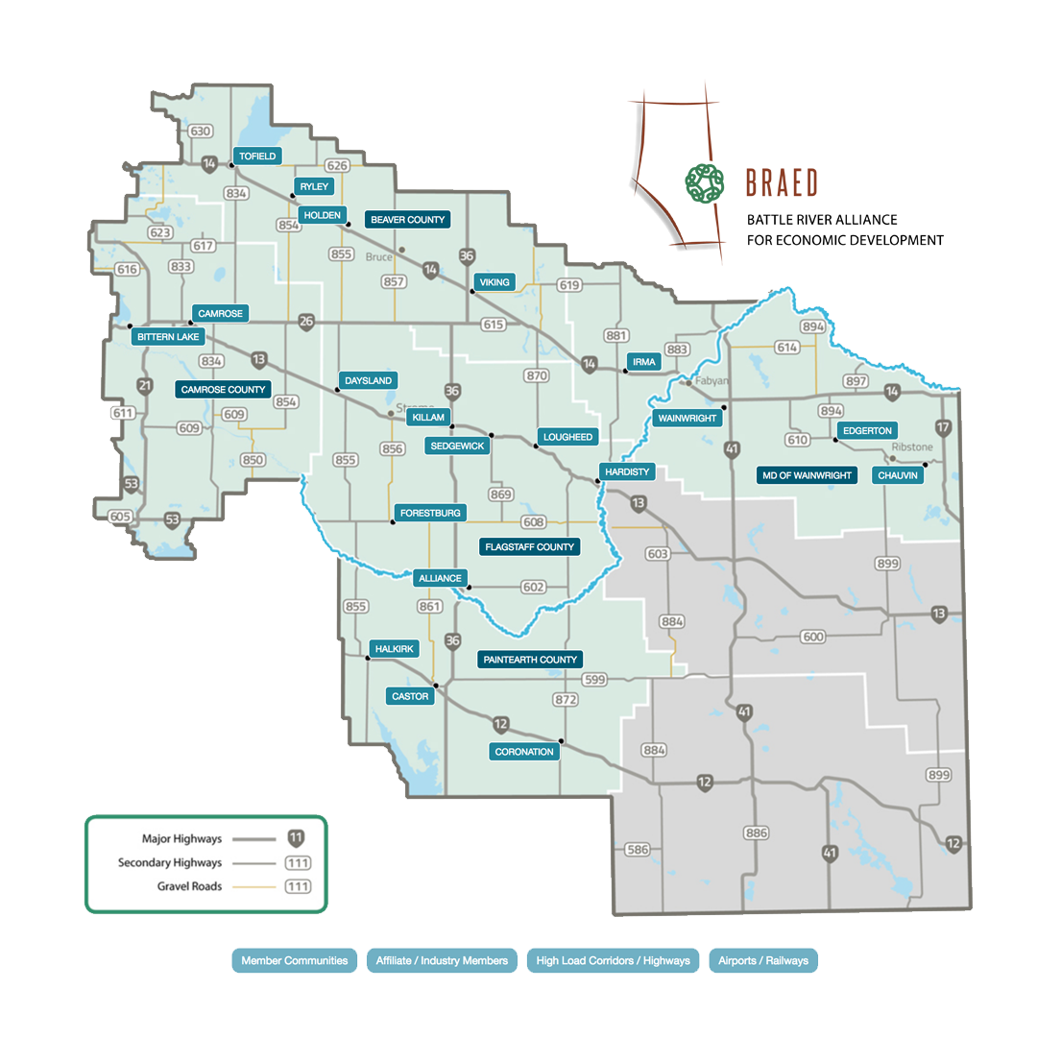

BRAED
Regional map

Slide 6
Invest Alberta – BRAED
Investor Attraction Pilot Project
Challenge
How to bridge the gap to investors

Slide 7
Invest Alberta – BRAED
Investor Attraction Pilot Project
Three steps
Build understanding of the investment cycle
Build and populate pro forma community prospectuses
Build and deliver a mock investor tour

Slide 8
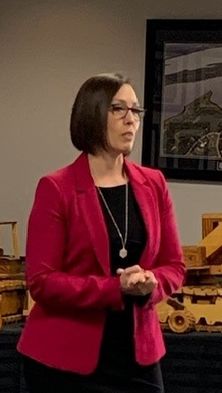
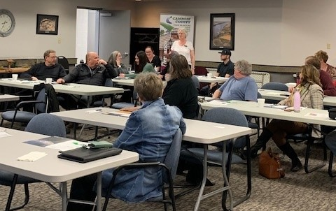
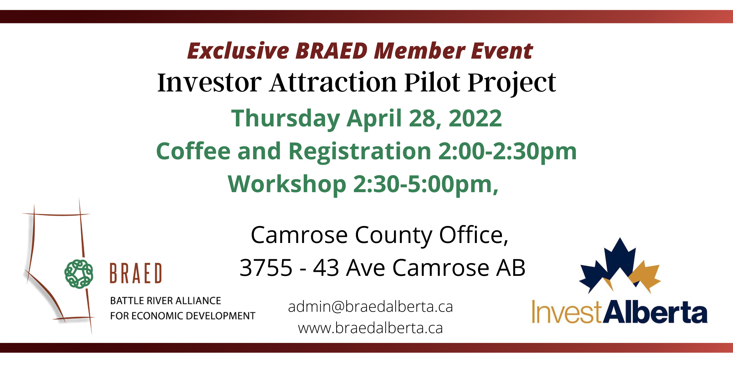
Invest Alberta – BRAED
Investor Attraction Pilot Project
Build understanding of the investment cycle

Slide 9
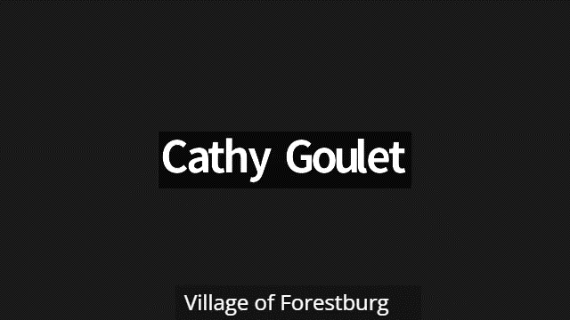
Invest Alberta – BRAED
Investor Attraction Pilot Project
Blaise Young, Mayor, Village of Forestburg

Slide 10
Invest Alberta – BRAED
Investor Attraction Pilot Project
Build and populate pro forma prospectuses
Participants
Paintearth County
Flagstaff County
Village of Irma
Village of Forestburg
Camrose County
Town of Hardisty
Town of Wainwright
Village of Lougheed
Camrose City

Slide 11
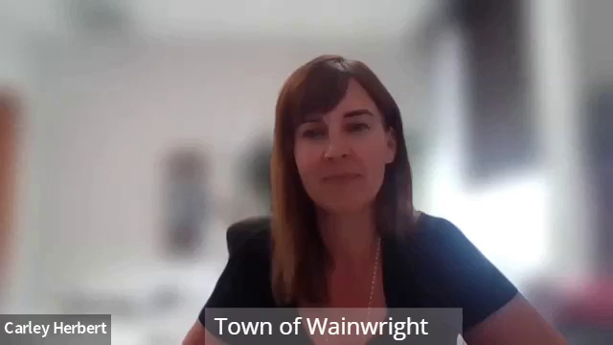
Invest Alberta – BRAED
Investor Attraction Pilot Project
Carley Herbert, Economic Development Officer, Town and MD of Wainwright

Slide 12
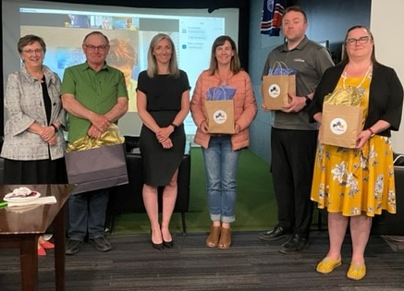
Invest Alberta – BRAED
Investor Attraction Pilot Project
Pro forma prospectuses… and the winners are
Paintearth County
Wainwright and the MD of Wainwright
City of Camrose and Camrose County

Slide 13
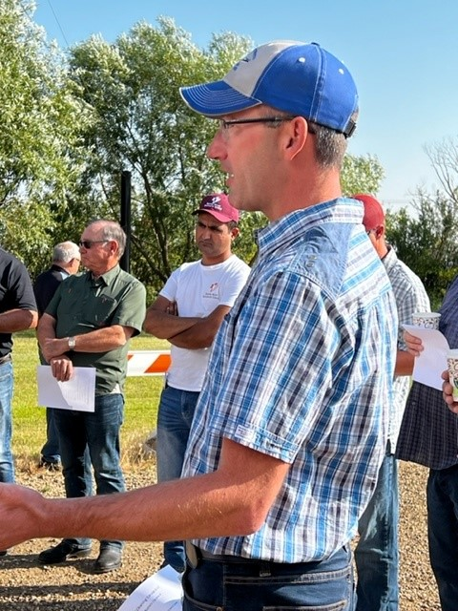
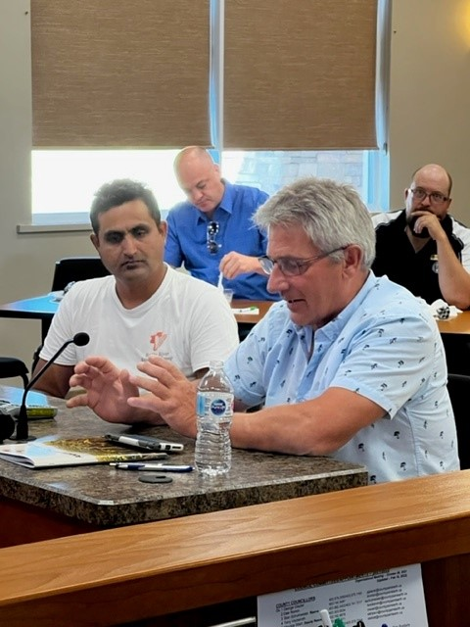
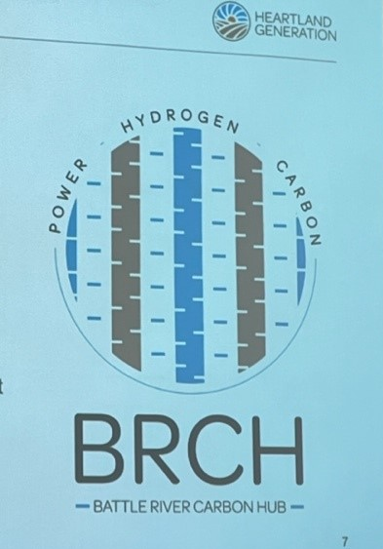
Invest Alberta – BRAED
Investor Attraction Pilot Project
Build and deliver a mock investor tour
Paintearth County

Slide 14
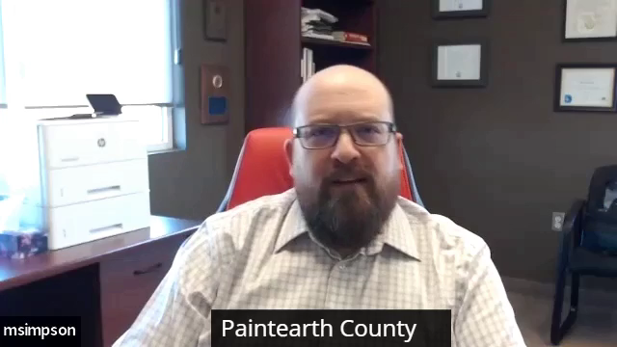
Invest Alberta – BRAED
Investor Attraction Pilot Project
Michael Simpson, CAO Paintearth County

Slide 15
Invest Alberta – BRAED
Investor Attraction Pilot Project
Next Steps
Feedback for Paintearth County on mock investor tour
Paintearth County Lessons Learnt presentation at September BRAED BOD meeting
Completed community prospectuses are featured on Invest Alberta website

Slide 16
Invest Alberta – BRAED
Investor Attraction Pilot Project
Thank you
Questions?

